Slide 1
GPS Navigation
1. Problem Statement and Defining a Path as a Series of Poses

Slide 2
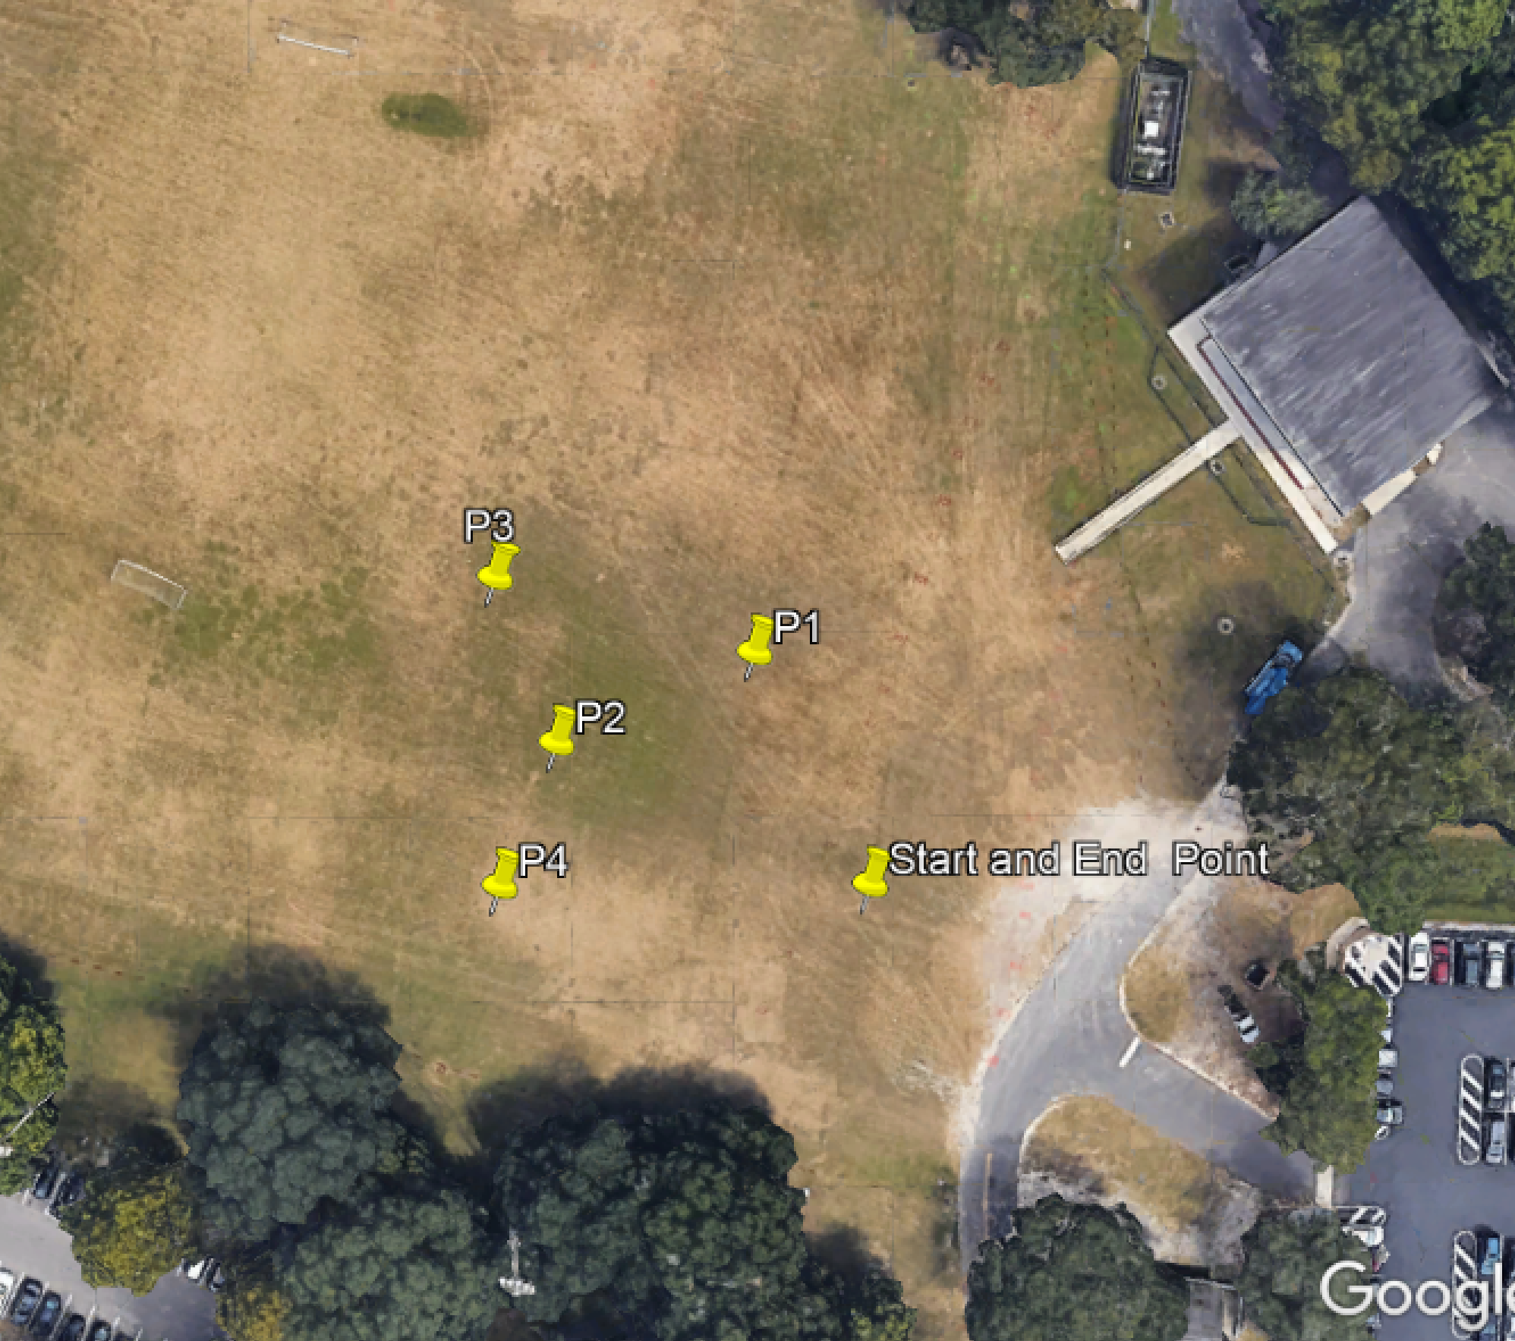
Problem Statement
given:
latitude and longitude of four points
start and end location
perform the following:
navigate from the start location to within 2m of each of the points and then back to the start location
points can be visited in any order
bag data in order to create an xy plot (x is East and y is North) showing the start location, the four points and the motion path of the vehicle (could overlay into Google Earth) ; upload plot to Canvas
upload your package package to Canvas

Slide 3
Problem Statement
Task 1:
the start point and the other four points were selected graphically using Google Earth
how to get the coordinates of these points?
save and parse .kml file of point locations
point | latitude | longitude
start | 29.64617356 | -82.35372189
1 | 29.64638940 | -82.35384503
2 | 29.64630503 | -82.35405655
3 | 29.64645891 | -82.35412200
4 | 29.64617282 | -82.35411713

Slide 4
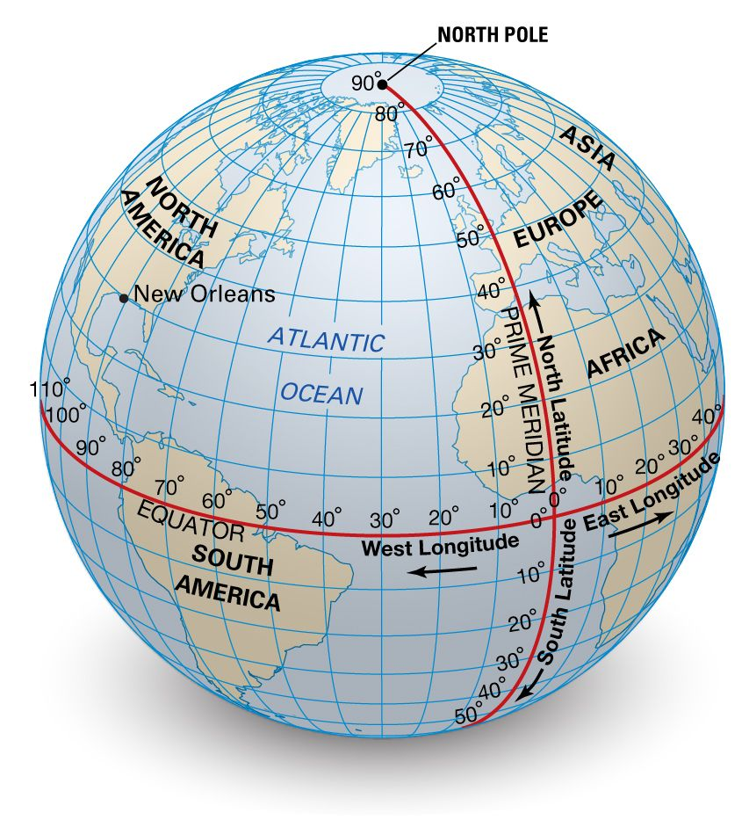
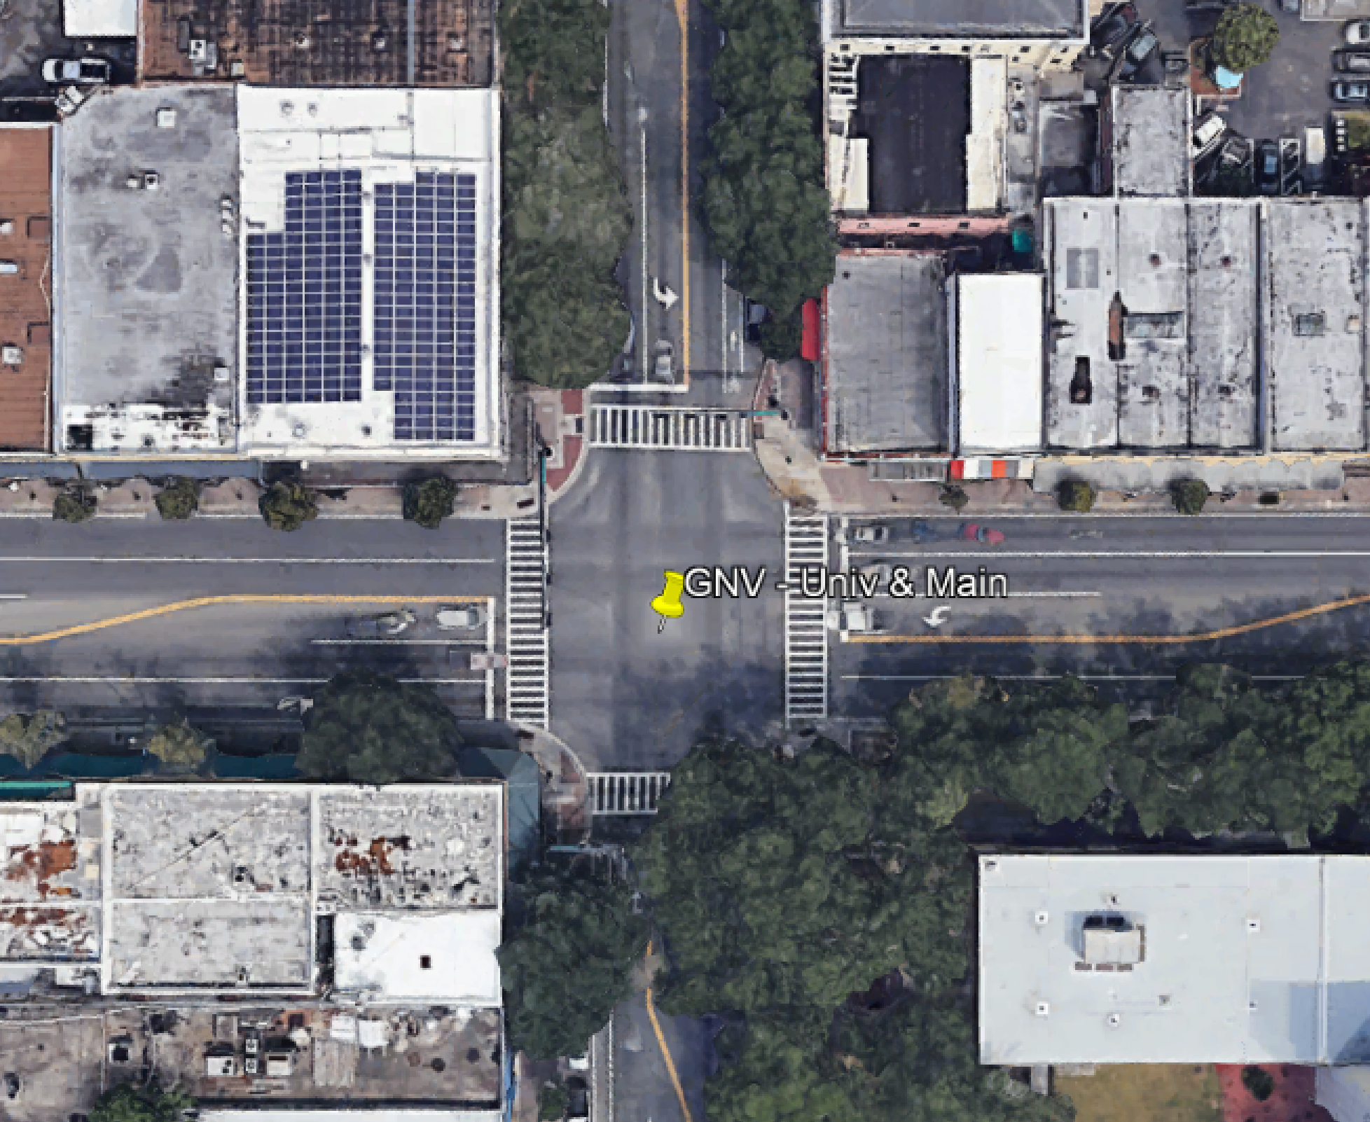
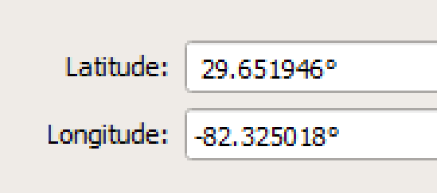
Coordinate Systems
using the latitude/longitude coordinate data is awkward (for us)
we would like x y in units of meters

Slide 5
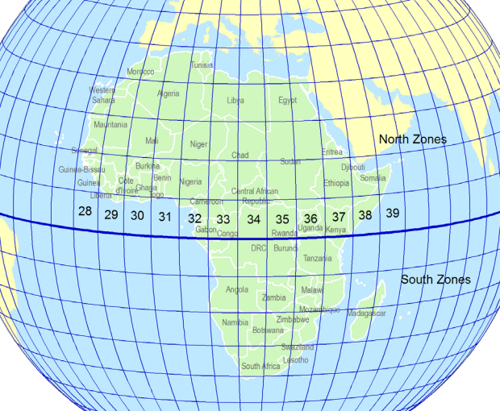
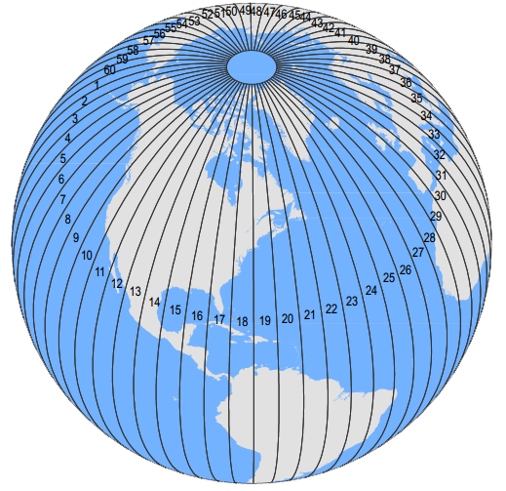
Universal Transverse Mercator (UTM) Coordinates

Slide 6
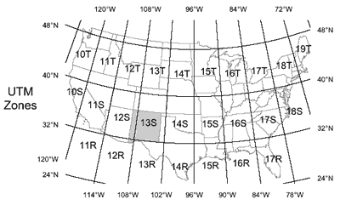

Slide 7
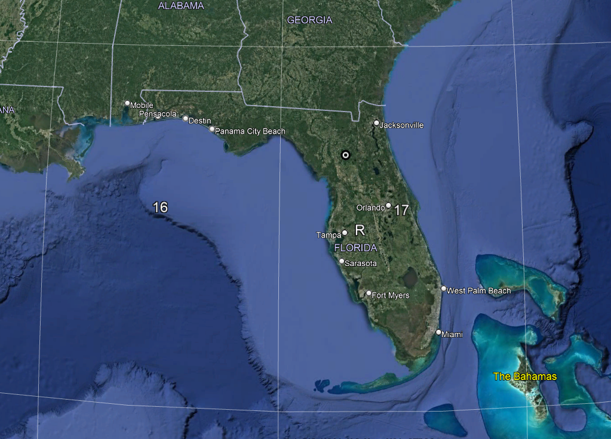
UTM coordinate system in Zone 17 R
x axis will be East
y axis will be North
distance units are in meters

Slide 8
How to convert from lat/long to UTM?
Method 1
py convert_to_UTM.py input_file.txt output_file.txt
input file has latitude and longitude separated by a comma on each line
output file will have Easting, Northing, Zone Number, and Zone letter on each line, separated by a comma
input file:
29.6461735604169, -82.3537218948119
29.6463893972471, -82.3538450308533
29.6463050340523, -82.3540565509504
29.6464589142567, -82.3541220000679
29.6461728159732, -82.3541171317863
output file: (units of meters ; ‘too many’ significant figures)
368969.70858622075 , 3280345.325842864 , 17 , R
368958.06839763390 , 3280369.383803328 , 17 , R
368937.48358735227 , 3280360.274217328 , 17 , R
368931.34738749923 , 3280377.4010046674 , 17 , R
368931.44793484730 , 3280345.6906304797 , 17 , R

Slide 9
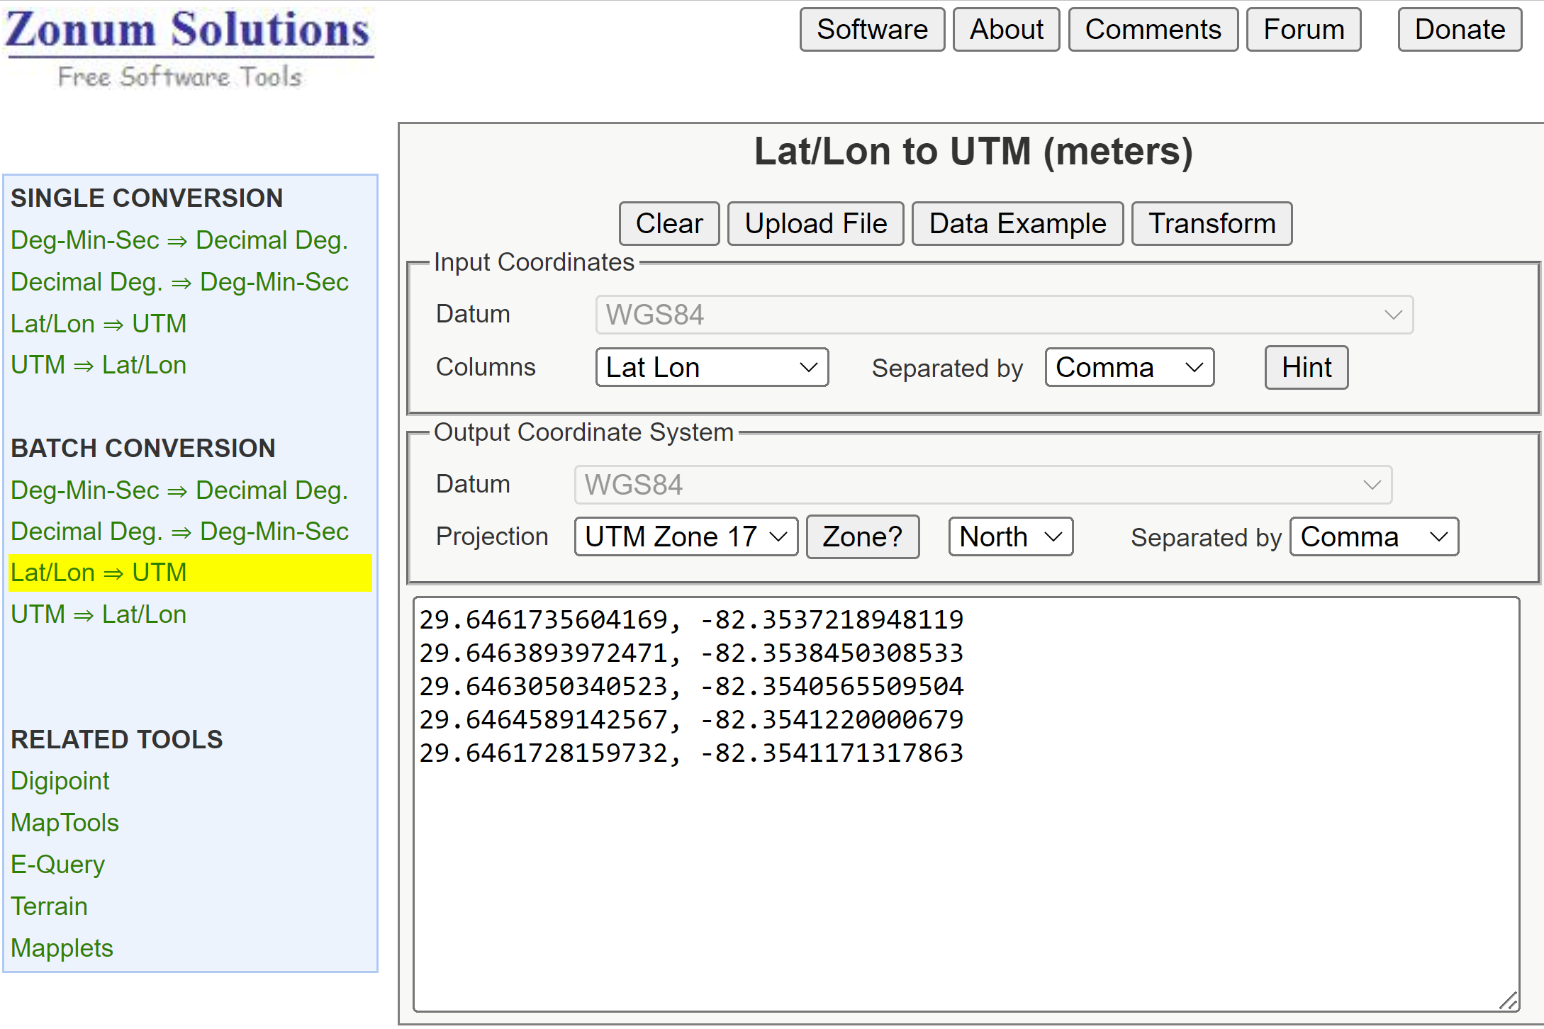
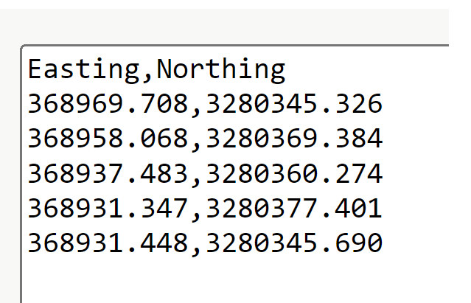
How to convert from lat/long to UTM?
Method 2 http://www.zonums.com/online/coords/cotrans.php?module=13

Slide 10
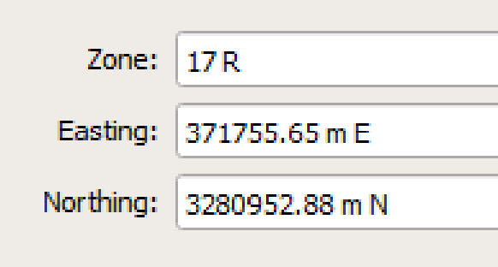
Coordinate Systems
UTM in Google Earth
Looks like Google Earth is offering cm level accuracy.

Slide 11
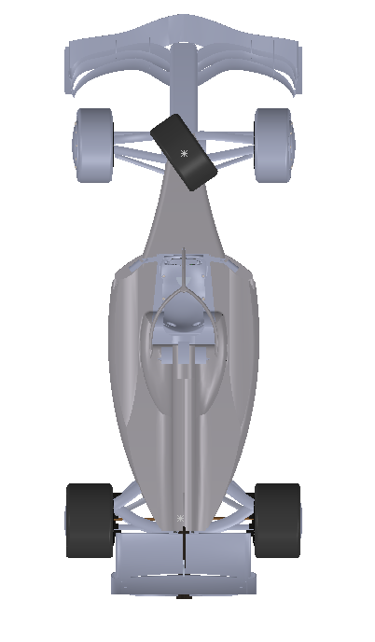
More about coordinate systems
Attach a coordinate system to the vehicle. We chose x_{veh} as ‘forward’ and z_{veh} as ‘up’.
We will keep track of the vehicle pose (position & orientation) in terms of the world system by the coordinates of point P_{vo} and the angle θ.
We will use UTM coordinates (units of meters) for the x,y coordinates of ^{world}P_{vo}.
The angle θ will be measured from the direction of x_{world} to x_{veh} in a right-hand sense about z_{world}.
x_{veh}
θ
y_{world}
Vehicle Coordinate System
World UTM Coordinate System
y_{veh}
P_{vo}
x_{world}

Slide 12
Some observations:
x_{veh}
y_{world}
θ
Vehicle Coordinate System
World UTM Coordinate System
y_{veh}
P_{vo}
x_{world}
direction vectors have no dimensions

Slide 13
Coordinate Transformation Problem
given:
find:
P₁
1.2 m
2.5 m
y_{world}
x_{veh}
θ
Vehicle Coordinate System
y_{veh}
P_{vo}
x_{world}
World UTM Coordinate System

Slide 14
Coordinate Transformation Problem
given:
find:
P₁
1.2 m
2.5 m
y_{world}
x_{veh}
θ
Vehicle Coordinate System
y_{veh}
P_{vo}
Vwo→Po
x_{world}
World Coordinate System

Slide 15
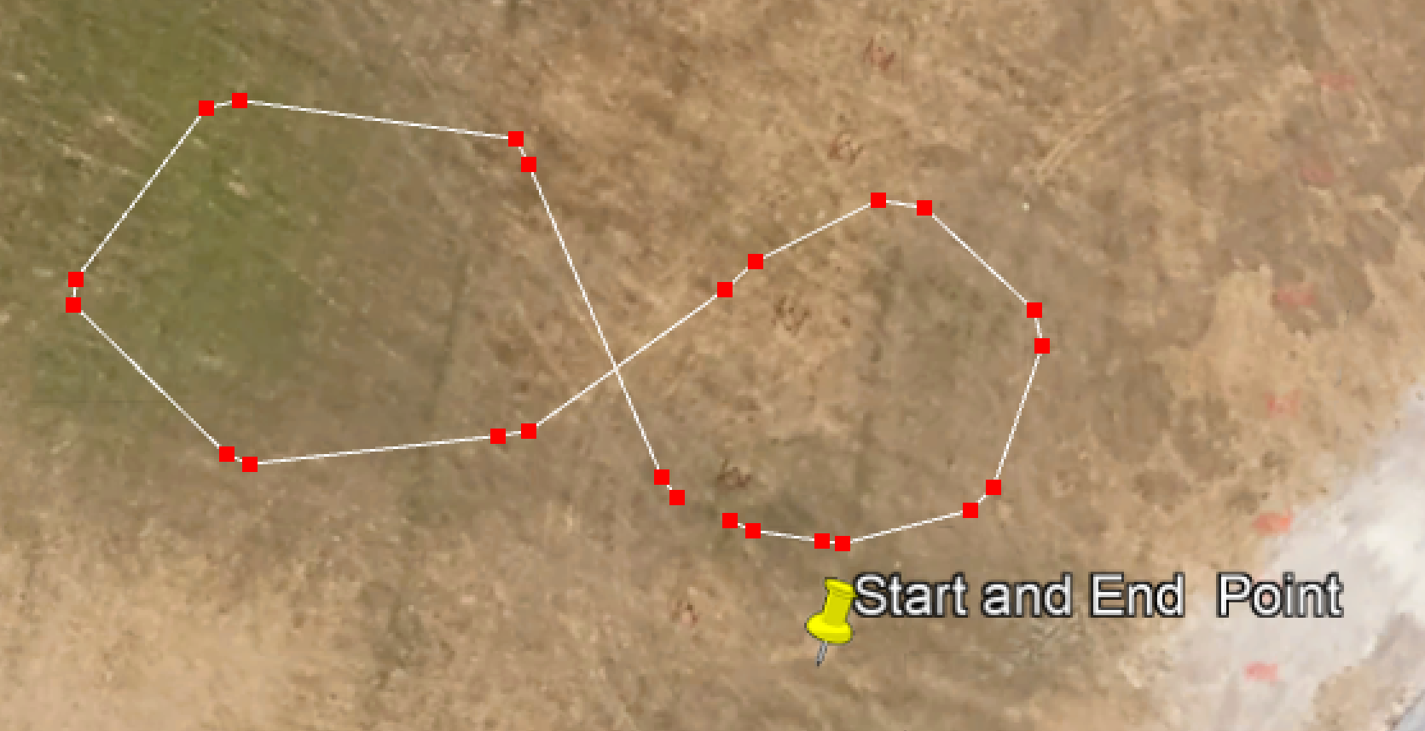
GPS Nav
How to start the navigation process?
generate a text file that contains on each line:
#ptx (m), pty (m), azim_deg (deg), state
this is a series of desired poses to move through
a pose is a position and orientation, i.e. (x,y) cords of vehicle origin point and orientation angle θ
can generate a pose in Google Earth by selecting two points
first point is the desired position of the vehicle origin point
the line from the first to the second point will define the desired orientation, i.e. θ
save the path file as a .kml file
longitude, latitude, elevation can be obtained from the file
need to do some Excel ‘magic’ to get a text file that has x, y in UTM on each line
notepad ++ with find/replace
web site transform to UTM
more ‘magic’ to get θ from adjacent pair of points
excel manipulations
save a csv file with x, y, θ, state
Google Earth path
python3 kml_to_route.py mypath.kml poses.csv
python3 process_pose_list.py poses.csv path_segs.csv
Start Pose
End Pose

Slide 16
GPS Nav
#Easting,Northing,theta (deg),state
368964.381,3280351.686,126.29,1
368958.905,3280364.326,116.02,1
368947.966,3280366.829,-167.45,1
368941.709,3280360.149,-96.23,1
368947.337,3280353.54,-24.52,1
368957.605,3280354.088,8.67,1
368966.361,3280359.5,41.56,1
368972.295,3280362.842,-9.84,1
368978.236,3280358.596,-78.99,1
368976.551,3280351.907,-136.78,1
368970.704,3280349.861,172.20,1
368967.284,3280350.395,155.50,1
This will be our ‘starting’ file.
Google Earth path
Start Pose
End Pose

Slide 17
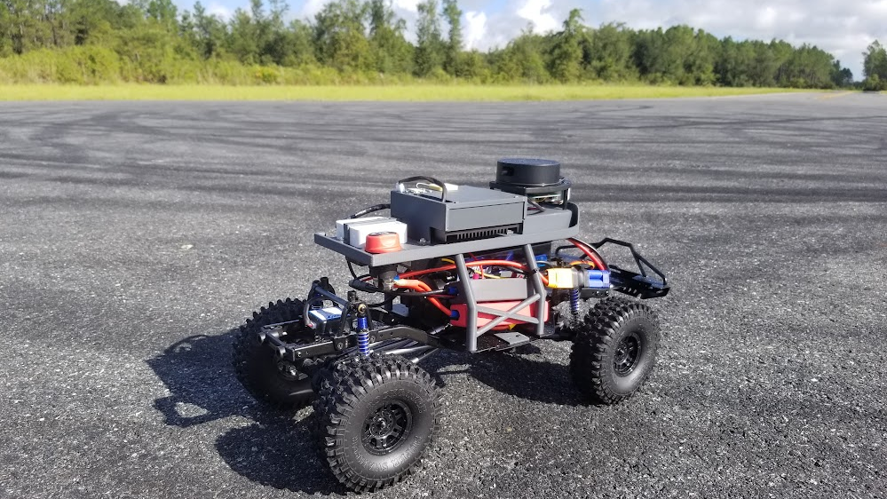

Next Up
How do we measure the vehicle pose?
How do I make a ‘smooth continuous’ path through my list of poses?
How do I find the ‘closest pose’ on the path to my current pose?
How do I command the steering (and throttle) to ‘best’ follow the path?

